Slide 1
Interprocess Communication Chapter 3

Slide 2
Interprocess Communication
Processes within a system may be independent or cooperating
An independent process cannot affect or be affected by execution of another process
A cooperating process can affect or be affected by the execution of another process
Reasons for cooperating processes:
Information sharing
Computation speedup
Modularity
Convenience
Cooperating processes need inter-process communication (IPC)

Slide 3
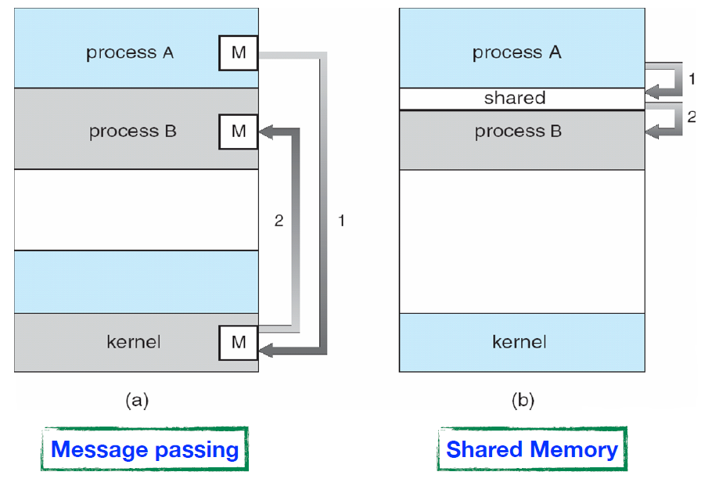
Communications Models
Two models of IPC
Message passing
Shared memory

Slide 4
IPC – Shared Memory Model
A region of memory shared among the processes that wish to communicate.
The communication is under the control of the users processes not the OS.
Used for large amount of data transfer.
Major issues is to provide mechanism that allows the user processes to synchronize their actions when they access shared memory.
Mostly used in shared memory systems.

Slide 5
IPC – Message Passing Model
Message passing – process communication without resorting to shared variables
IPC facility provides two operations:
send(message) – message size fixed or variable
receive(message)
If two processes wish to communicate, they need to:
Establish a communication link between them
Exchange messages via send/receive
Several choices in communication link implementation
Direct or indirect communication,
Synchronous or asynchronous communication
Automatic or explicit buffering
Mostly used in distributed systems, for small amount of data transfer (fixed or variable length messages) as it is time consuming

Slide 6
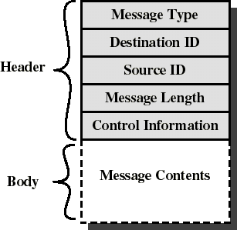
Message Format
Consists of header and body of the message
In UNIX: no ID, only message type
Control Information
What to do if run out of buffer space
Sequence numbers
Priority
Queuing discipline: usually FIFO but can also include priorities

Slide 7
Implementation Questions
How are links established?
Can a link be associated with more than two processes?
How many links can there be between every pair of communicating processes?
What is the capacity of a link?
Is the size of a message that the link can accommodate fixed or variable?
Is a link unidirectional or bi-directional?

Slide 8
Direct Communication
Processes must name each other explicitly:
send (P, message) – send a message to process P
receive(Q, message) – receive a message from process Q
Properties of direct communication link
Links are established automatically
A link is associated with exactly one pair of communicating processes
Between each pair there exists exactly one link
The link may be unidirectional, but is usually bi-directional

Slide 9
Indirect Communication
Messages are directed and received from mailboxes (also referred to as ports)
Each mailbox has a unique id
Processes can communicate only if they share a mailbox
Properties of communication link
Link established only if processes share a common mailbox
A link may be associated with many processes
Each pair of processes may share several communication links
Link may be unidirectional or bi-directional

Slide 10
Indirect Communication
Operations
create a new mailbox
send and receive messages through mailbox
destroy a mailbox
Primitives are defined as:
send(A, message) – send a message to mailbox A
receive(A, message) – receive a message from mailbox A

Slide 11
Indirect Communication
Mailbox sharing – consider the following …
P₁, P₂, and P₃ share mailbox A
P₁, sends; P₂ and P₃ receive
Who gets the message?
Possible Solutions to avoid unpredictable behavior
Allow a link to be associated with at most two processes
Allow only one process at a time to execute a receive operation
Allow the system to select arbitrarily the receiver. Sender is notified who the receiver was.

Slide 12
Synchronization
Message passing may be either blocking or non-blocking
Blocking is considered synchronous
Blocking send -- the sender is blocked until the message is received
Blocking receive -- the receiver is blocked until a message is available
Non-blocking is considered asynchronous
Non-blocking send -- the sender sends the message and continue
Non-blocking receive -- the receiver receives a valid message or null
message next_produced;
while (true) { /* produce an item */
send(next_produced);
}
message next_consumed;
while (true) {
receive(next_consumed);
/* consume the item */
}

Slide 13
Link Capacity – Buffering
Regardless of how messages are exchanged between processes, messages are queued
Queuing can be implemented in one of three ways
1. Zero capacity – queue has maximum length of 0 Sender must wait (or block) until the receiver gets the message
2. Bounded capacity – queue has finite length of n messages Sender must wait if link full
3. Unbounded capacity – queue has “infinite” length Sender never waits

Slide 14
Examples of IPC Systems – POSIX
Process first creates shared memory segment
segment_id = shmget(IPC_PRIVATE, size, S_IRUSR | S_IWUSR);
Process wanting access to that shared memory must attach to it
shared_memory = (char *) shmat(segment_id, NULL, 0);
Now the process could write to the shared memory
sprintf(shared_memory, "Writing to shared memory");
When done a process can detach the shared memory from its address space
shmdt(shared_memory);
Now process can remove the shared memory segment
shmdt(shared_id, IPC_RMID, NULL);

Slide 15
Examples of IPC Systems – Mach
Mach communication is message based:
Even system calls are messages.
Each task gets two mailboxes at creation: Kernel and Notify.
Only three system calls needed for message transfer:
msg_send(), msg_receive(), msg_rpc()
Mailboxes needed for communication, created via
port_allocate()

Slide 16
Examples of IPC Systems – Windows XP
Message-passing centric via Local Procedure Call (LPC) facility:
Only works between processes on the same system.
Uses ports (like mailboxes) to establish and maintain communication channels.
Communication works as follows:
The client opens a handle to the subsystem’s connection port object.
The client sends a connection request.
The server creates two private communication ports and returns the handle to one of them to the client.
The client and server use the corresponding port handle to send messages or callbacks and to listen for replies.

Slide 17
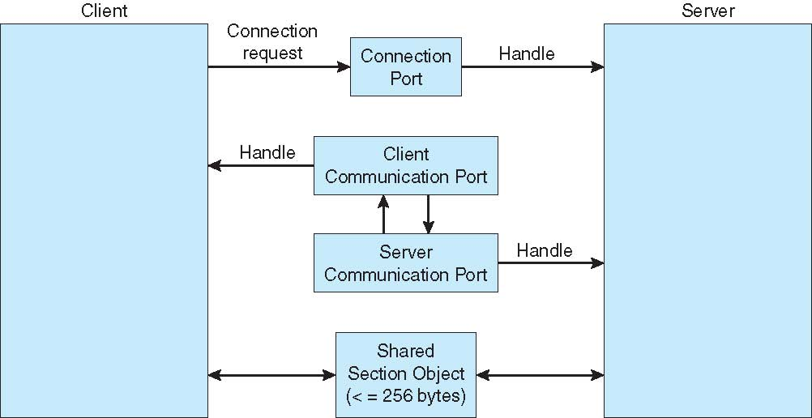
Local Procedure Calls in Windows XP

Slide 18
Communications in Client-Server Systems
There are various mechanisms:
Sockets (Internet)
Remote Procedure Calls (RPCs)
Pipes
Remote Method Invocation (RMI, Java)

Slide 19
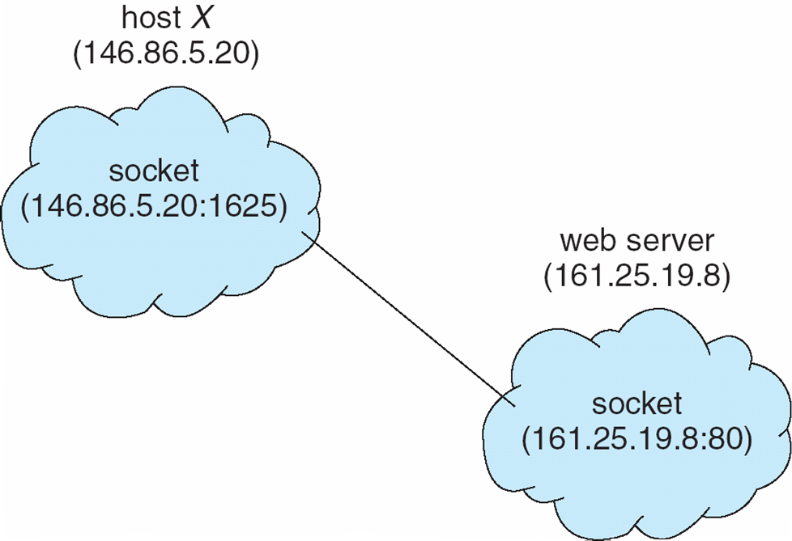
Sockets
A socket is defined as an endpoint for communication.
Concatenation of IP address and port.
The socket 161.25.19.8:1625 refers to port 1625 on host 161.25.19.8
Communication consists between a pair of sockets
All ports below 1024 are well known, used for standard services
Special IP address 127.0.0.1 (loopback) to refer to system on which process is running

Slide 20
Remote Procedure Calls (RPCs)
RPC abstracts a Local Procedure Call between processes on a networked system.
Stubs – client-side proxy for the actual procedure on the server.
The client-side stub locates the server and marshals the parameters.
The server-side stub receives this message, unpacks the marshalled parameters, and performs the procedure on the server.
Vice versa happens on the opposite direction.
On Windows, stub code compile from specification written in Microsoft Interface Definition Language (MIDL)
Data representation handled via External Data Representation (XDL) format to account for different architectures (Big-endian and little-endian)

Slide 21
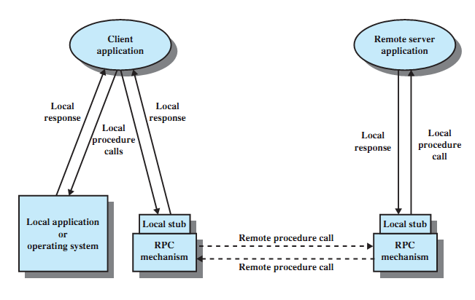
Remote Procedure Call Mechanism

Slide 22
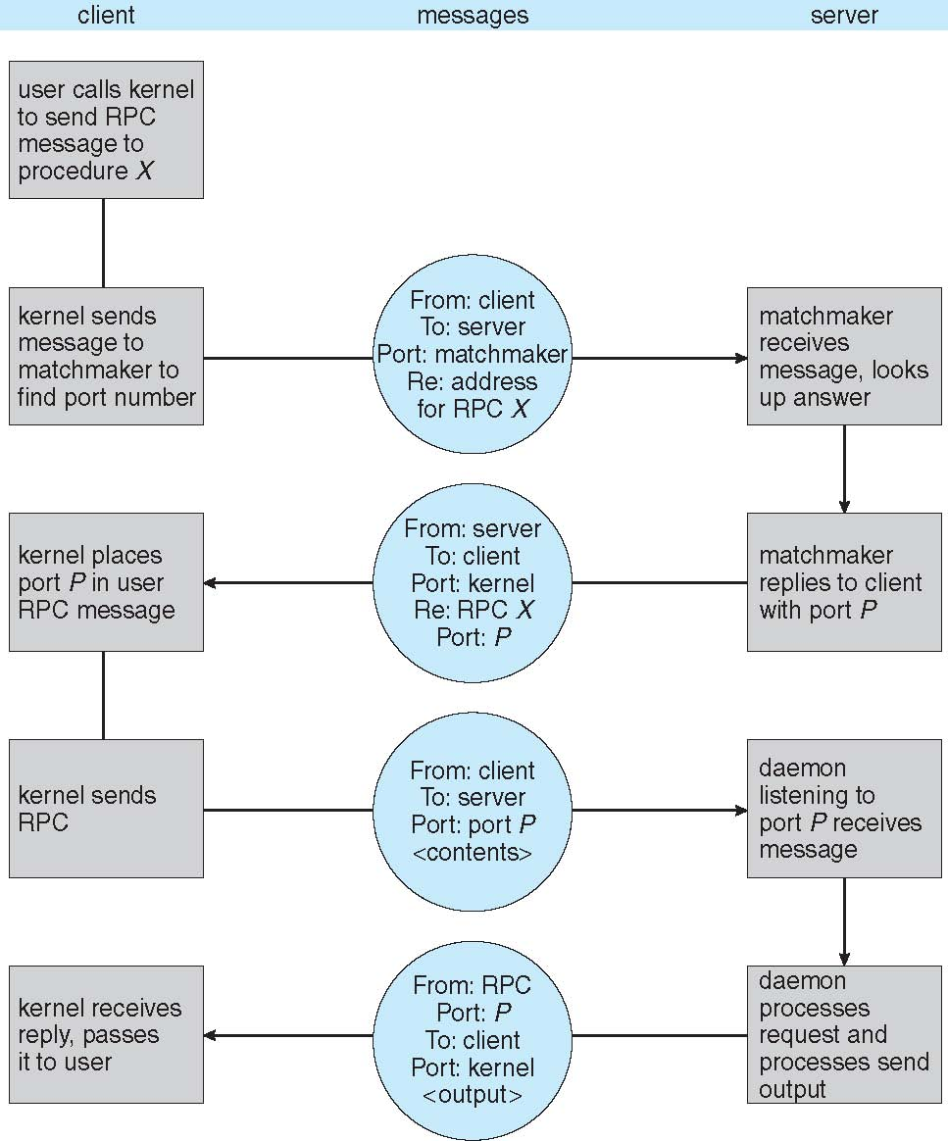
Execution of RPC

Slide 23
Pipes
Acts as a channel allowing two processes to communicate
Some Issues:
Is communication unidirectional or bidirectional?
In the case of two-way communication, is it half or full-duplex?
Must there exist a relationship (i.e. parent-child) between the communicating processes?
Can the pipes be used over a network?
Ordinary pipes – cannot be accessed from outside the process that created it. Typically, a parent process creates a pipe and uses it to communicate with a child process that it created.
Named pipes – can be accessed without a parent-child relationship.

Slide 24
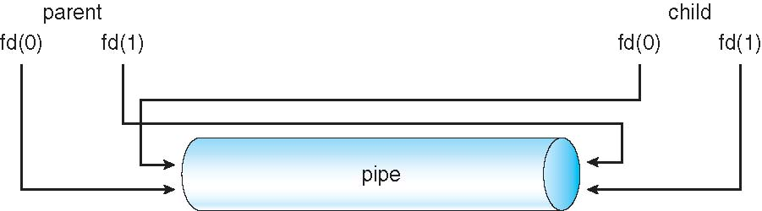
Ordinary Pipes
Ordinary Pipes allow communication in standard producer-consumer style
Producer writes to one end (the write-end of the pipe)
Consumer reads from the other end (the read-end of the pipe)
Ordinary pipes are therefore unidirectional
Require parent-child relationship between communicating processes

Slide 25
Named Pipes
Named Pipes are more powerful than ordinary pipes
Communication is bidirectional
No parent-child relationship is necessary between the communicating processes
Several processes can use the named pipe for communication
Provided on both UNIX and Windows systems

Slide 26
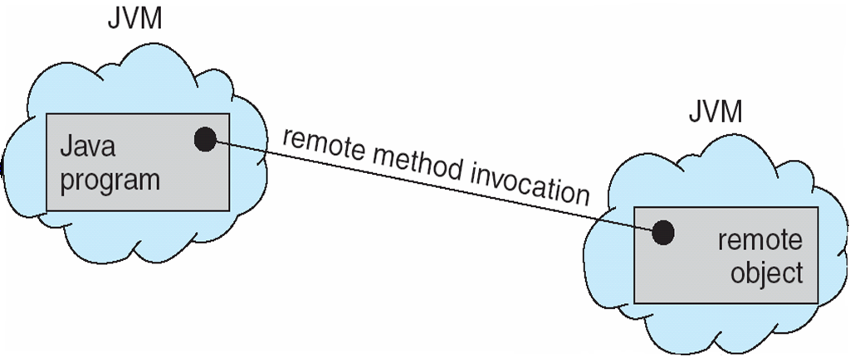
Remote Method Invocation
Remote Method Invocation (RMI) is a Java mechanism similar to RPCs.
RMI allows a Java program on one machine to invoke a method on a remote object.

Slide 27
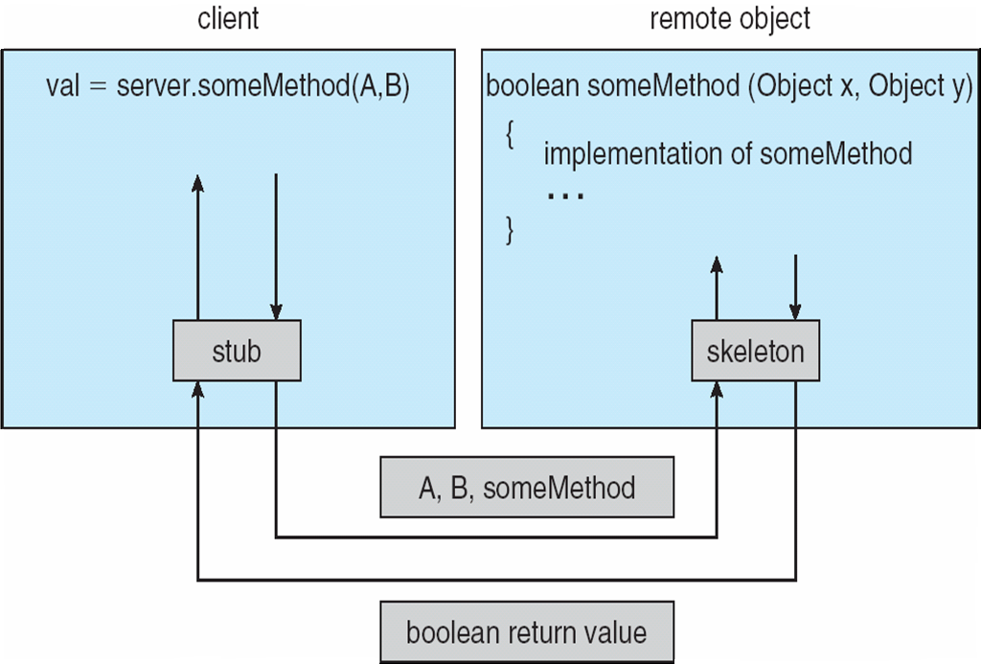
(Un)Marshalling Parameters

